Slide 1





Technical Evaluation – Microsoft SQL Server
Industry-leading performance
Least vulnerable database
Real-time intelligence
End-to-end mobile BI

Slide 2
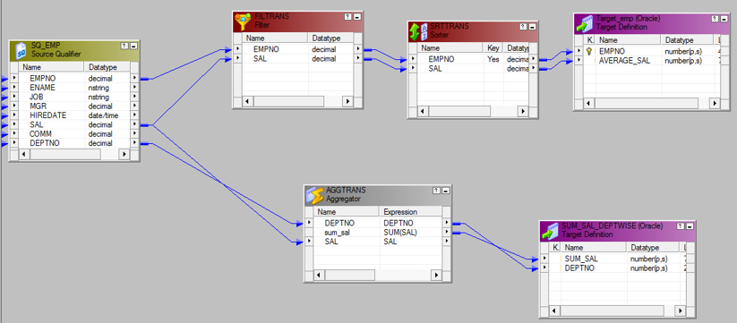
Technical Evaluation- Informatica PowerCenter
Informatica PowerCenter is a widely used ETL tool
PowerCenter provides the foundation for all major data integration projects
Access to almost any data source from one platform
Its simplify the development of data warehouses and data marts

Slide 3
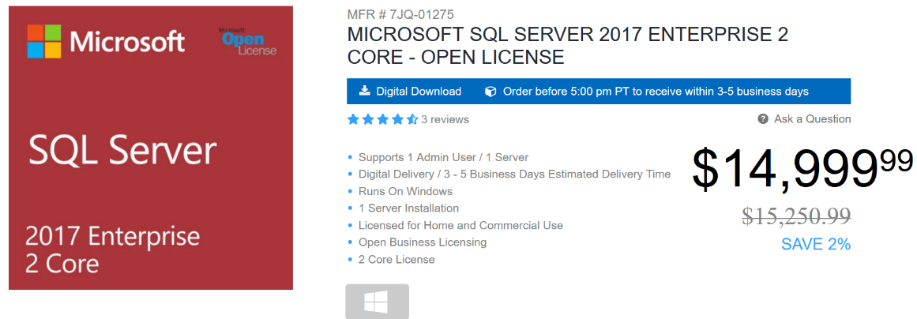
Cost Evaluation – SQL Server

Slide 4

Cost Evaluation - Informatica PowerCenter
Starting price $2,000 per month
Include 30 days free trail
Informatica PowerCenter is one of the best ETL tool

Slide 5
Risk Metrix
Variable | Low | Medium | Red
Technology | Expert level | Minimum experience | Little to no experience
Complexity | Minimal impact | Moderate impact | Extensive impact
Integration | Extensive integration | Limited integration | No integration
Organization | Solid internal support | Support to an extent | Low internal support
Project team | Business experience | Some business experience | No business experience
Financial Investment | ROI within short time | ROI within moderate time | ROI after a few years
Time | Adequate time | Moderate amount of time | Short time

